Slide 1

E-Commerce Data Analysis Product Categorization and Sales Prediction
By
Wale and Tiru
With professor
Ozgur Ozturk

Slide 2
Introduction
Product Categorization/Clustering and Sales Prediction
The process of putting together products which have similar product description.
This retail analytics helps the retailer to make smarter decisions toward higher profits, better customer satisfaction, and having a more successful business overall.
Over the years retail data has become increasingly important and vital for organizations to keep ahead of their competitors and keep increased levels of customer retention.
We chose this project to get better understanding on NLP specially the unsupervised learning topic modeling techniques.
We can be able to provide product suggestions for the customer based on customers preference of product categorization history.

Slide 3
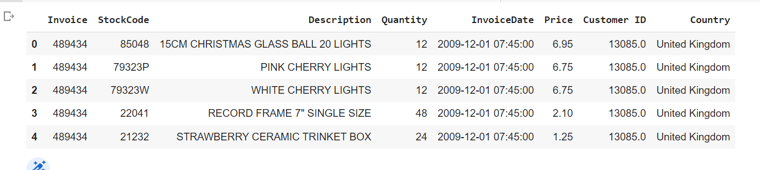
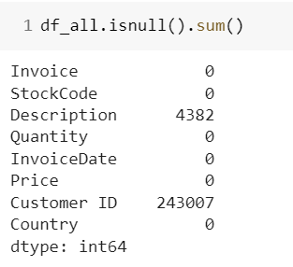
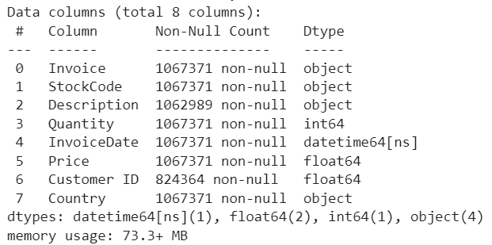
Dataset
This Online Retail II data set contains all the transactions occurring for a UK-based and registered, non-
store online retail between December 2009 and December 2011.The company mainly sells unique all-occasion giftware. Many customers of the company are wholesalers.
Data file currently holds 1,067,371 records with 8 features(columns)
1 customer can have multiple invoices (transactions)
Features include…
Invoice
Stock Code
Description
Quantity
Invoice Date - Split into two columns one “Date” & “Time”
Price
Customer ID
Country
Data source: https://archive.ics.uci.edu/ml/machine-learning-databases/00502/
we handled the NULL values by
- Drop NULL values in “Description” column since they’re aren’t that many.
- We kept the customer Id null values since it is not used in the analysis.

Slide 4
Methodology
In this project we can be able to apply various machine learning and NLP techniques to tackle the hidden structure of the data.
Applied various NLP techniques for preprocessing text data
We implemented topic modeling for product categorization.
Prediction models – predicted the sales for the clusters that yield from the LDA topic modeling.
Visualize results using different tools such as matplotlib, seaborn, word cloud, pyLDAvis and others.

Slide 5
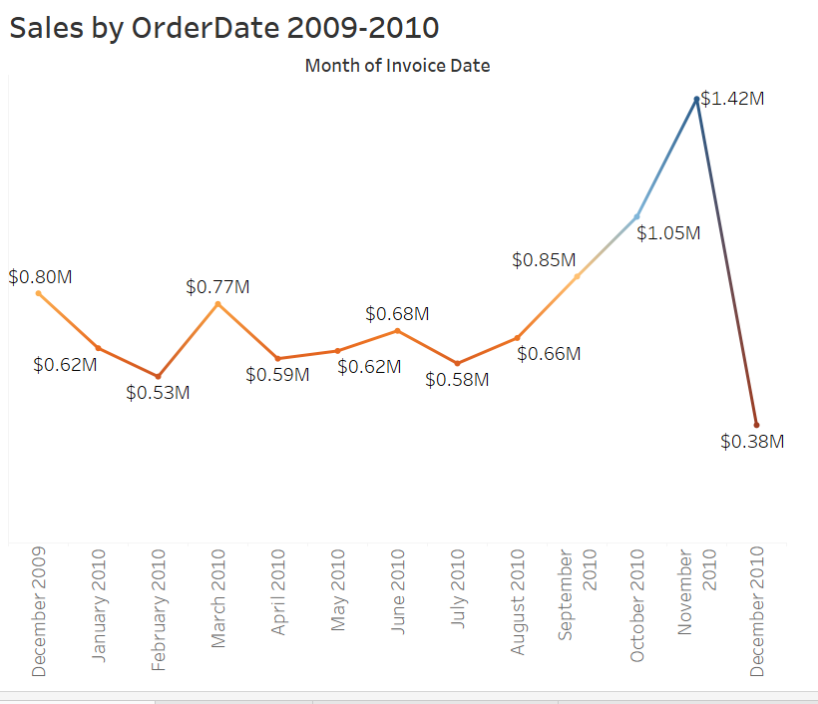
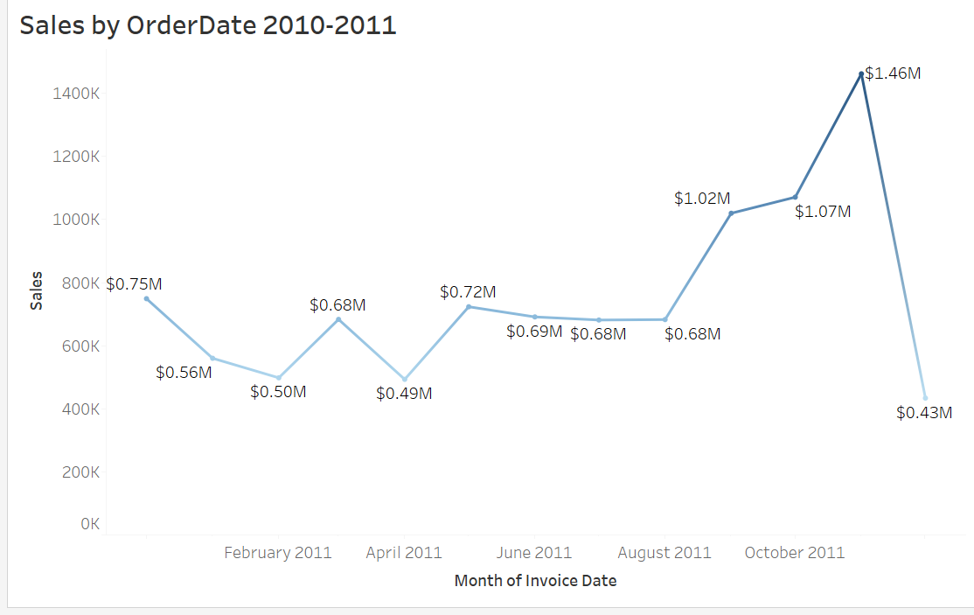
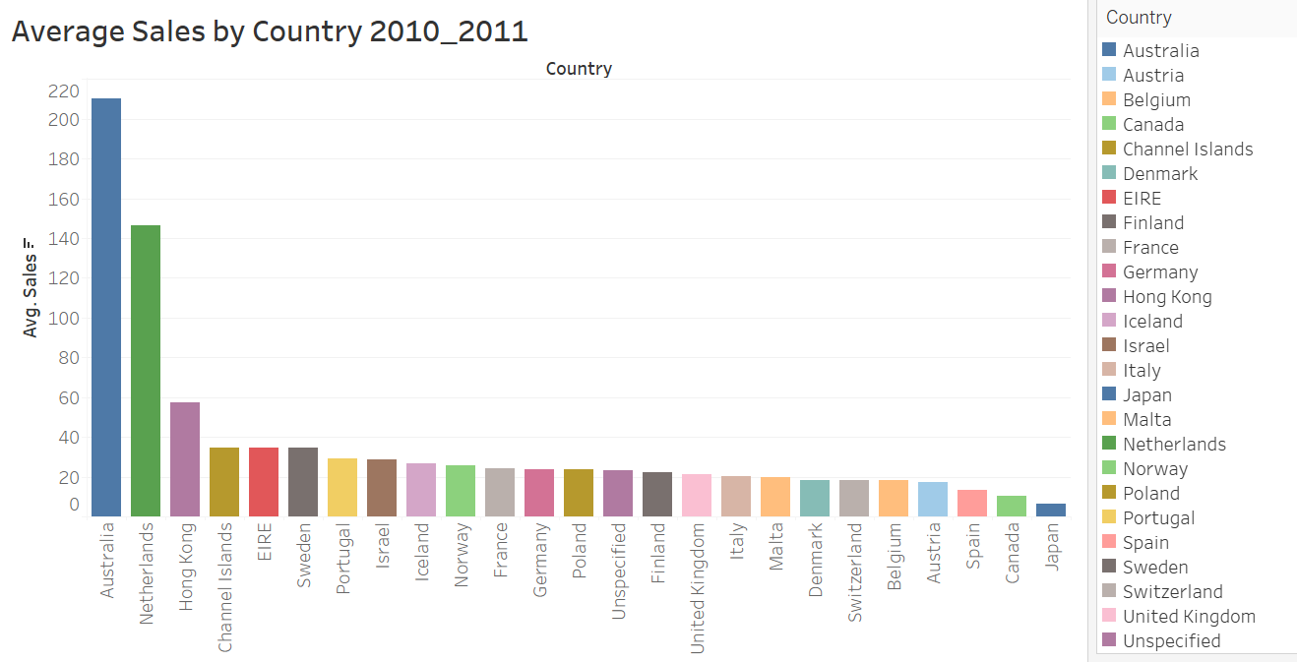
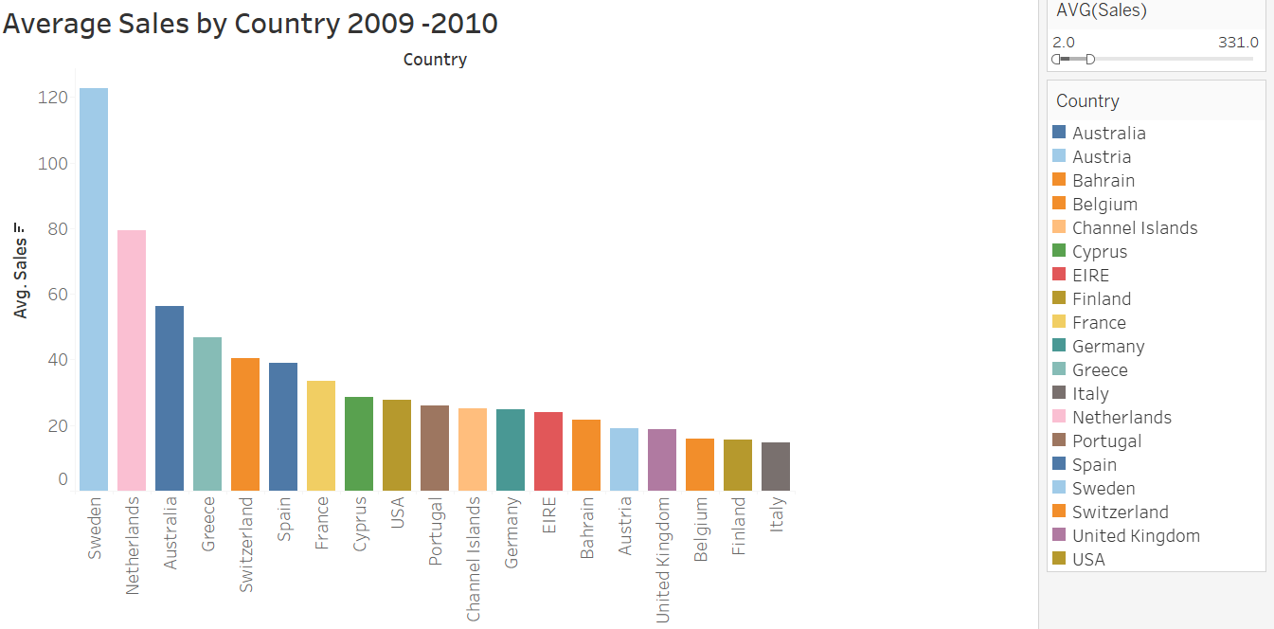
Data Exploration
We used tableau for exploration and data visualization.

Slide 6
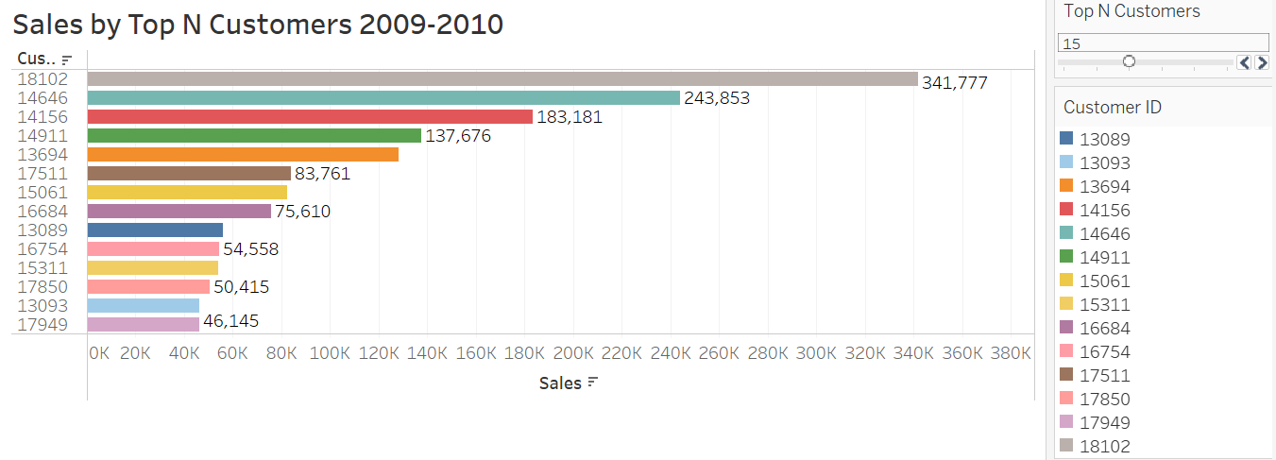
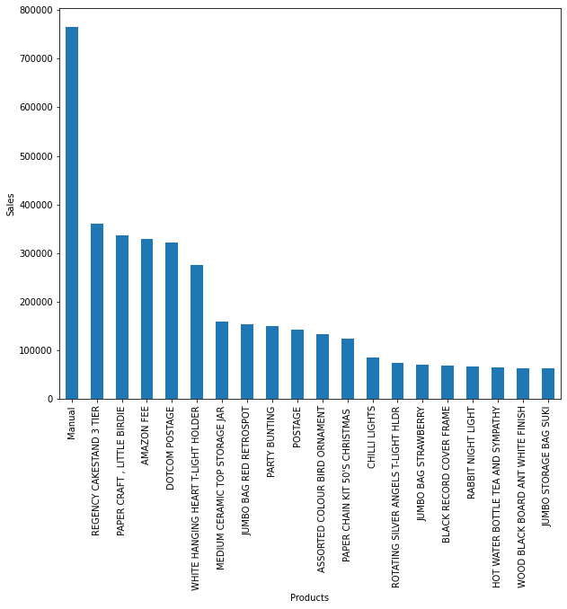
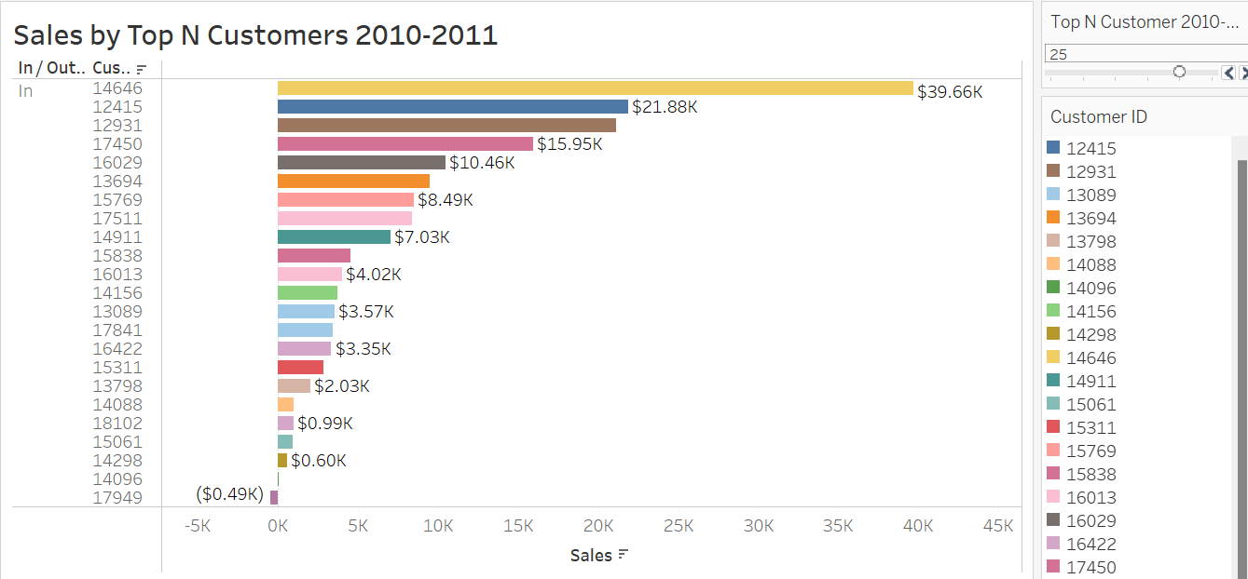
Data Exploration cont.

Slide 7
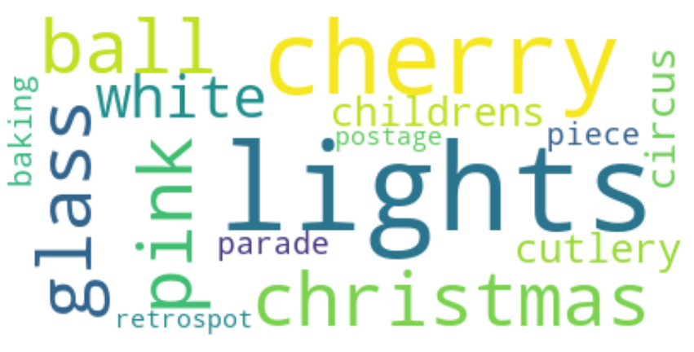
Product Categorization (Clustering)
Use NLP to process the data for clustering.
The description column was used for this purpose.
Applied NLP techniques to preprocess the data, such as tokenizing, change words into lower, remove stop words, remove punctuation, special characters, numbers and so on.
Created function to do all these stuffs
To the right you’ll see the word cloud after the data was preprocessed

Slide 8
Topic Modeling
Used gensim for further preprocessing and applied big-gram and tri-gram to help the model to understand words better incase it can’t recognize individual words.
Changed the data into a dictionary and applied TFIDF method to remove words which have high frequency but are not important to form the topics.
After we prepare the corpus, the next step is building the topic modeling.
It is unsupervised modeling helps to extract the main topic from the collection of documents.

Slide 9
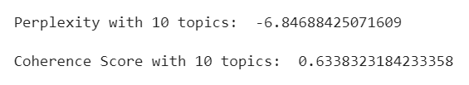
The LDA Model
LDA is used to classify texts in a document to a particular topic.
Used gensim library to build the LDA model and tried different number of topics and found the optimal number to group our corpus into particular topics was 10.

Slide 10
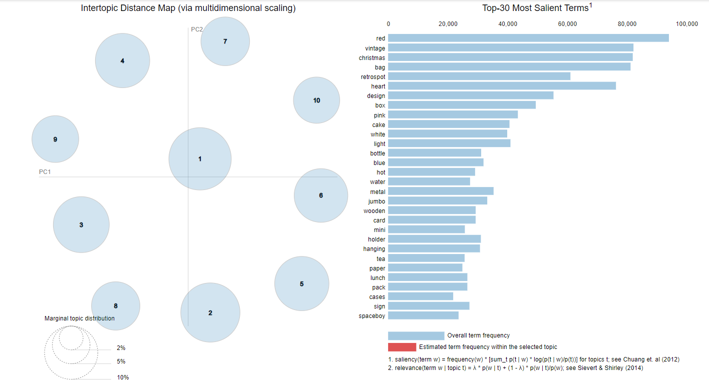
LDA Model Visualization by PyLDAvis

Slide 11
Sales Prediction Model
Data preparation for the prediction model
The LDA model provided each document with topics along with their probabilities.
Extract each document from the topic with maximum probability.
Add new Topic column into the original data frame.
For the sale prediction model only three columns were used, the invoice date, the sales and topic columns.
The total and the average sales for each cluster are shown on the next couple slides.

Slide 12
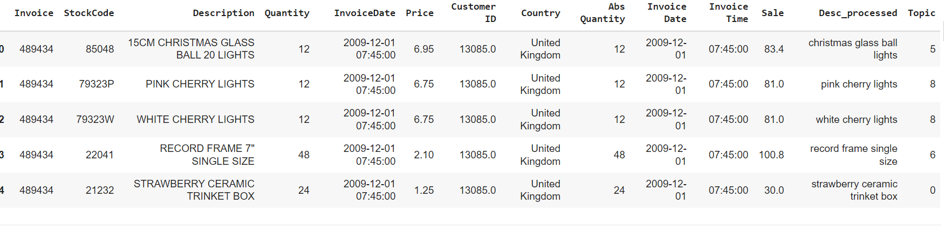
Updated Snapshot of Dataframe

Slide 13
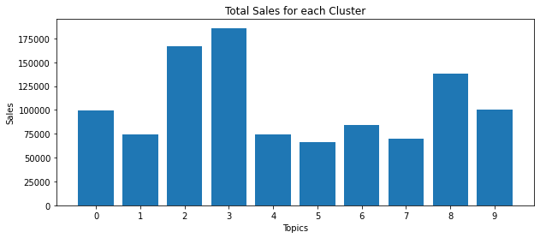
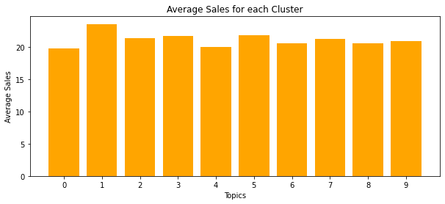
The Total And Average Sales For Each Topic

Slide 14
Time Series Analysis
Put each topic in its own sub dataframe for the analysis
Using resampling we changed the entries of the data into daily to keep the interval consistent.
The data has outliers, we took care of them using Interquartile range method.
Created a function to get the X features and y label from sales column.
Scaled the data and split it into the train and test set.

Slide 15
Regression Models
After we got the features and the label, we can run a regression model for the prediction of sales for each cluster.
Used LazyPredict model to see what regression models performed best on specific clusters. It helped select models that would be best for stacking.
We found different models perform well on different clusters and may require multiple models to be ran against them.
The Stacking model uses meta-learning algorithm to learn how to best combine the predictions from two or more base machine learning algorithms.
We used four base models for the stacking model i.e., ExtraTreesRegressor, AdaBoostRegressor, RandomForestRegressor and LinearSVR.
Linear Regression is the meta-model.

Slide 16
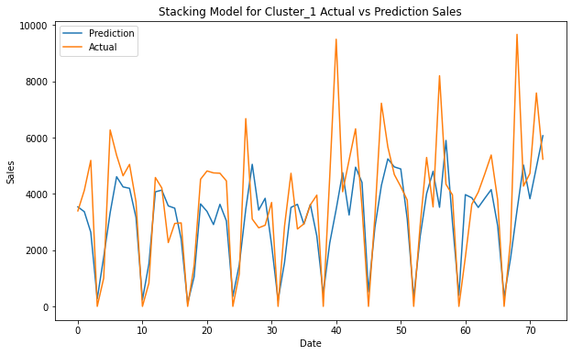
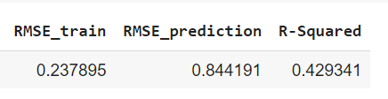
Stacking Model For Cluster 1
Trained the model and predicted on the unseen test dataset.
The graph shows the actual and the prediction move along
together except some spikes.
The performance metrics show that the model performed well.

Slide 17
LSTM Model For Cluster 1
When using a larger step size (30 in this case) the model performed well. Then we set up the X and y variables.
Split the dataset into train, validation and test datasets.
Scaled it and built the LSTM model.
Used simple neural network and trained the model

Slide 18
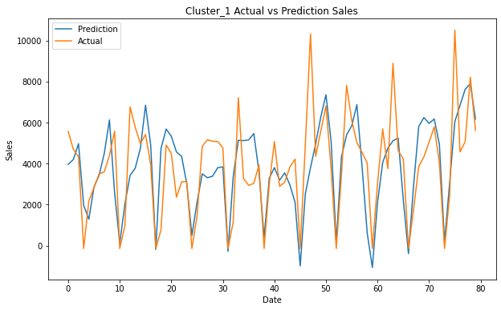
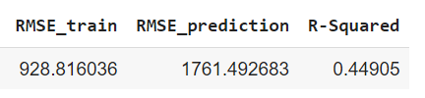
LSTM Model Performance Evaluation
As we see from the graph the LSTM model works well for this cluster.
The metrics show even though the model is overfitted, it performed better than the stacking model.

Slide 19
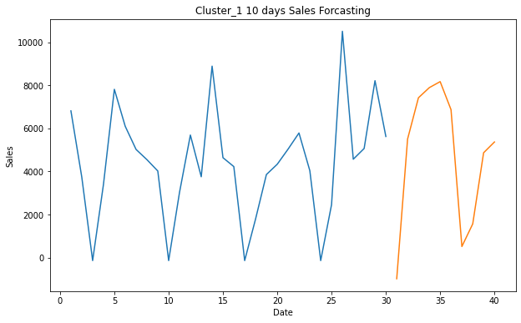
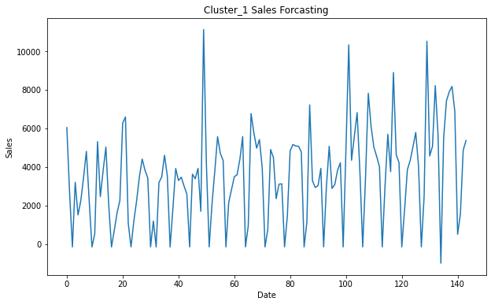
LSTM Forecasting for Cluster 1
Created a function that allow the model to forecast for the next 10 days starting from the last day of the test data date.
The first graph shows the 40 days of sales including the 10 forecasted sales.
The second graph shows the data all together from the beginning to the end but for clear visualization we used the last 150 days.
Overall you can see the forecasted values follow the data pretty well.

Slide 20
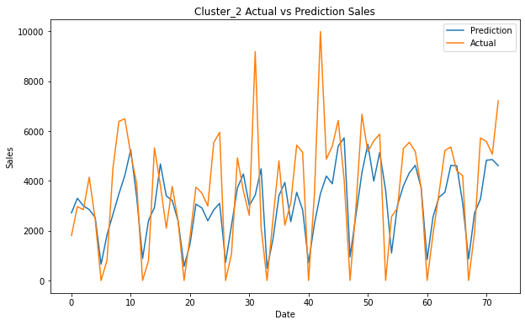
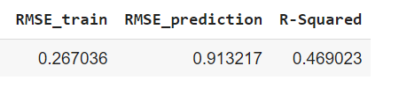
Stacking Model For Cluster 2
Trained the model and predicted on the unseen test dataset.
The graph shows the actual and the prediction plots move along together except the two high spikes.
The performance metrics show that the stacking model performed better than it did in cluster 1.

Slide 21
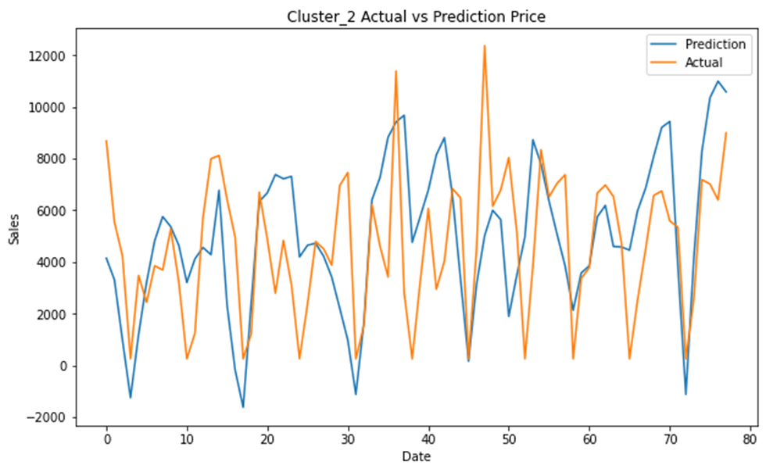
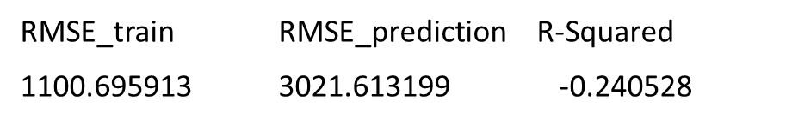
LSTM Model Performance Evaluation For Cluster 2
The LSTM model in cluster 2 is overfitted as we see the graph and the metrics.

Slide 22
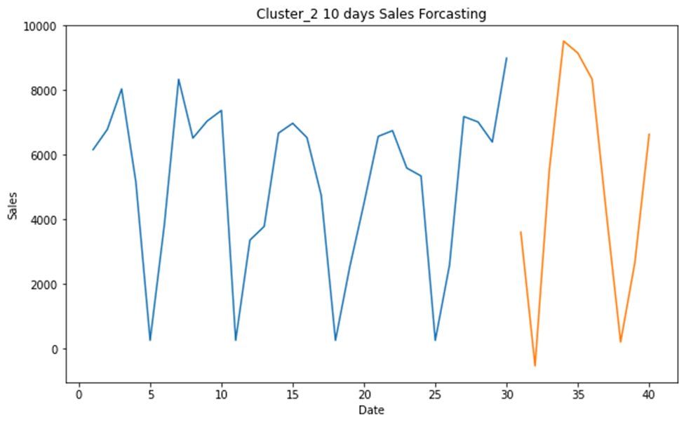
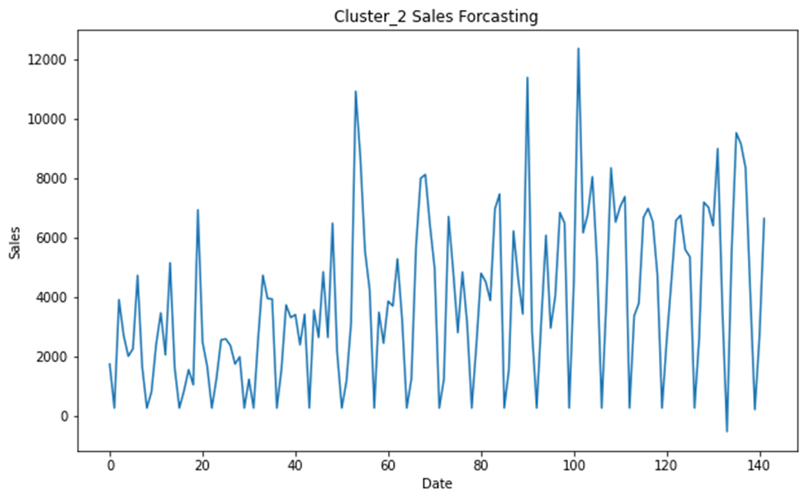
LSTM Model Forecasting for Cluster 2
The result of forecasting for 10 days seems not bad in this cluster.

Slide 23
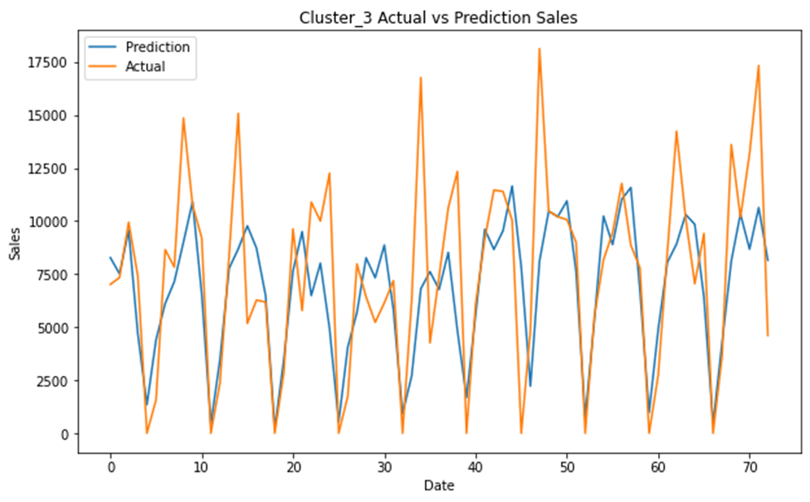
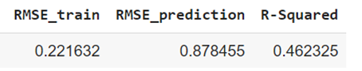
The Stacking Model For Cluster 3
The performance of the model in cluster 3 is similar cluster 2.

Slide 24
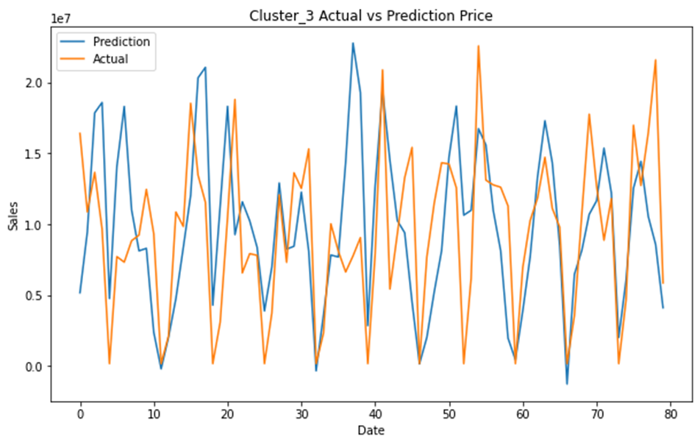
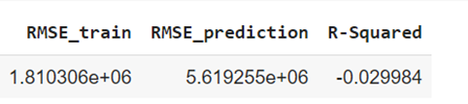
LSTM Model For Cluster 3
The LSTM model performance on cluster 3 is not good. The model is overfitted.

Slide 25
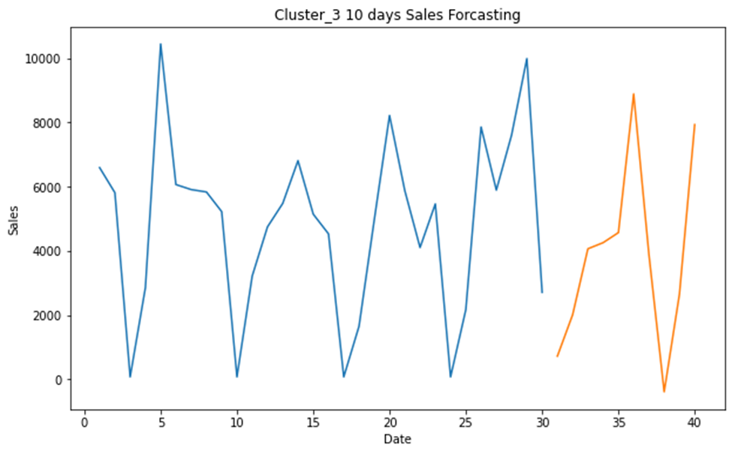
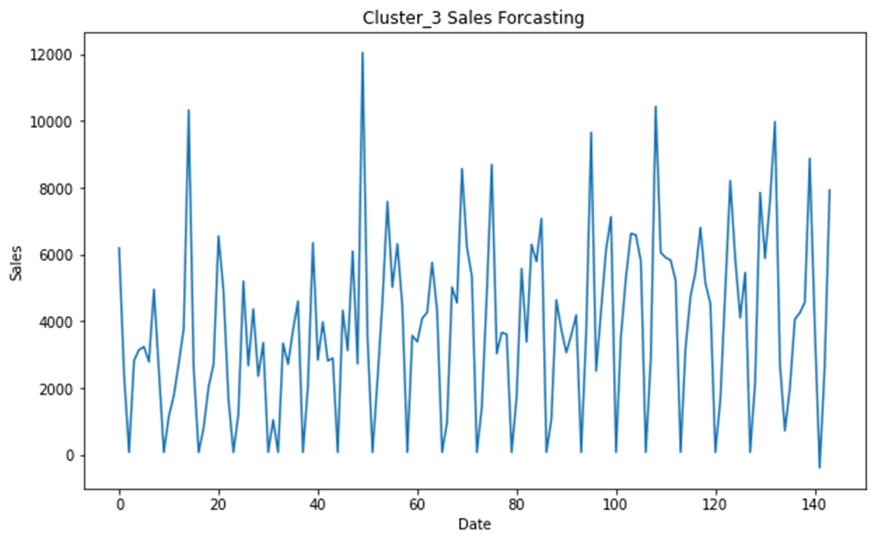
LSTM Model Forecasting For Cluster 3
The forecasting result in this cluster is not bad.

Slide 26
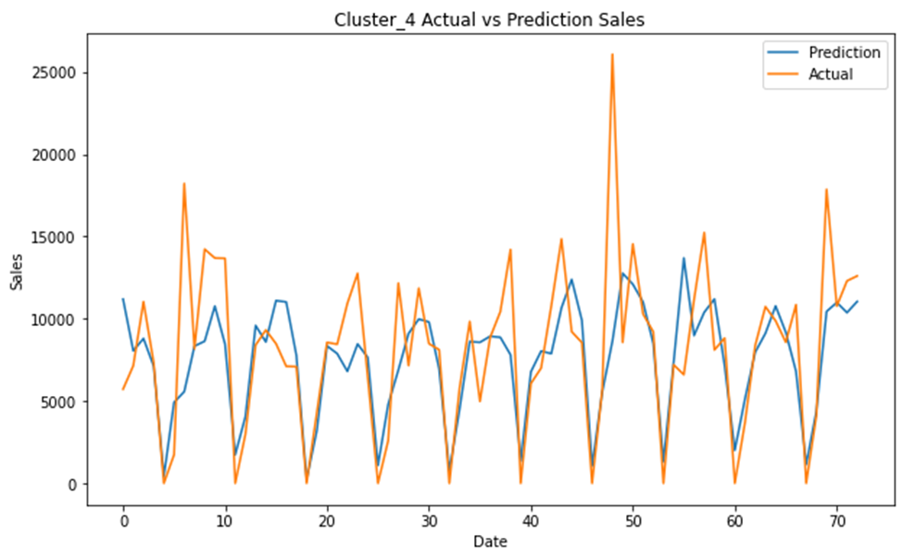
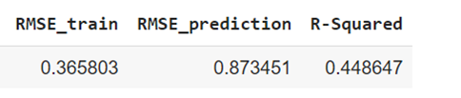
The Stacking Model For Cluster 4
The stacking model performance for this cluster is good. The model has problem to handle the seasonality of the data.

Slide 27
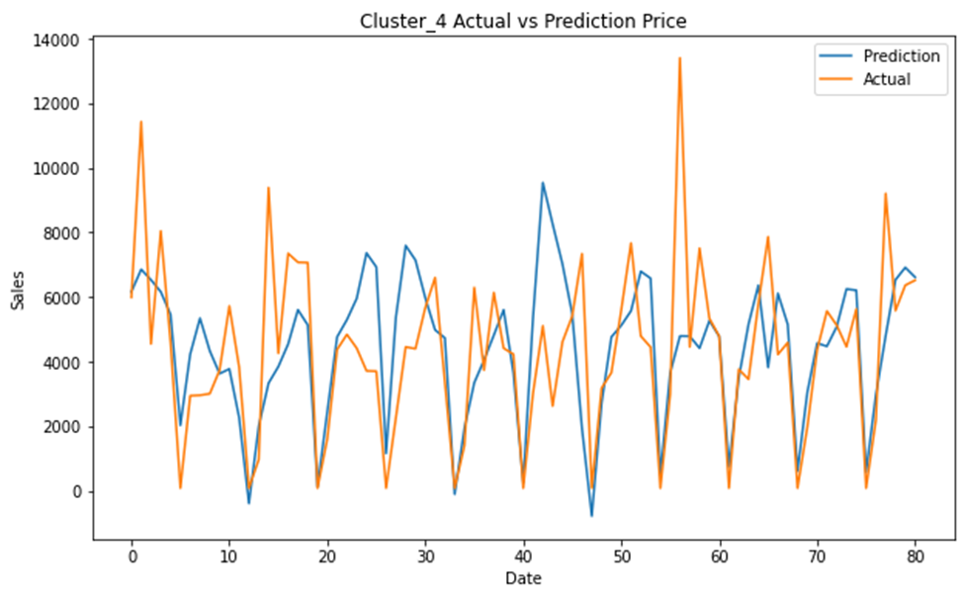
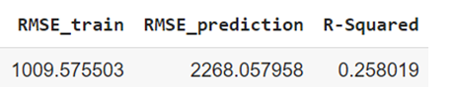
The LSTM Model Sales Prediction For Cluster 4
The LSTM model in this cluster is still overfitting but performed better than it did on cluster 2 and 3.

Slide 28
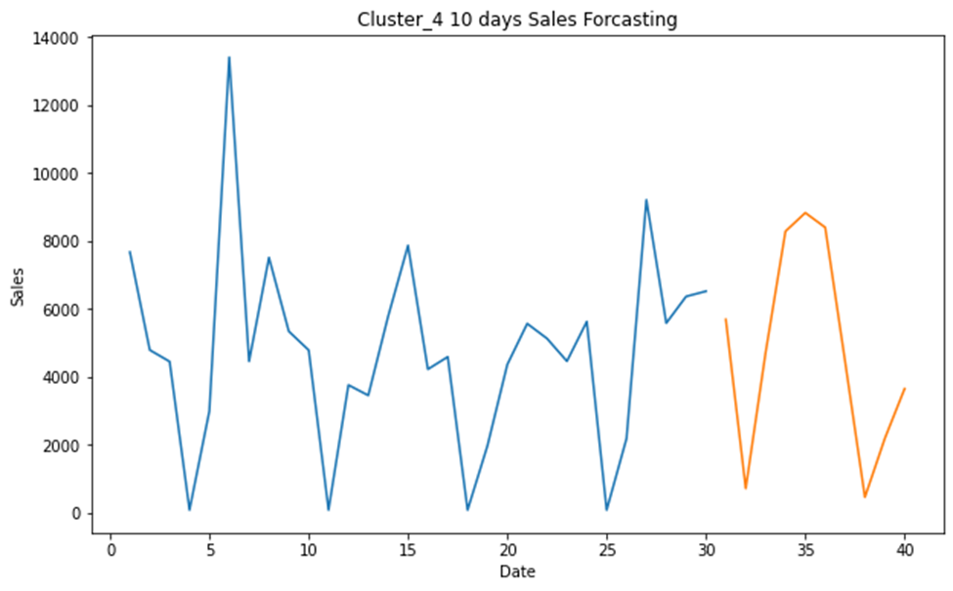
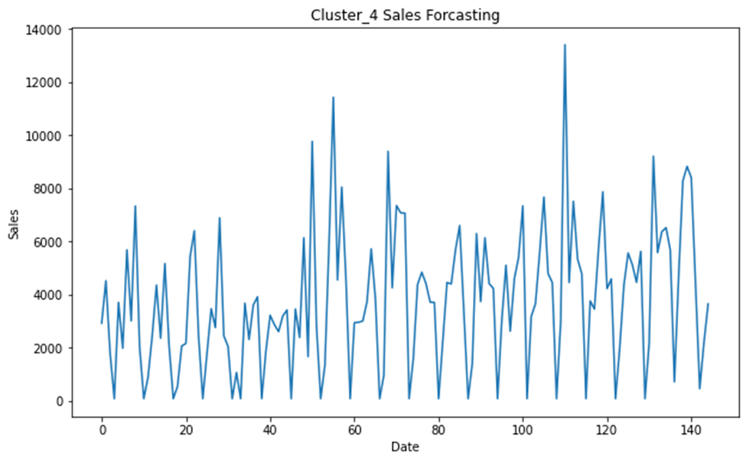
The LSTM Model Forecasting For Cluster 4
The forecasting result shows the model performed good.

Slide 29
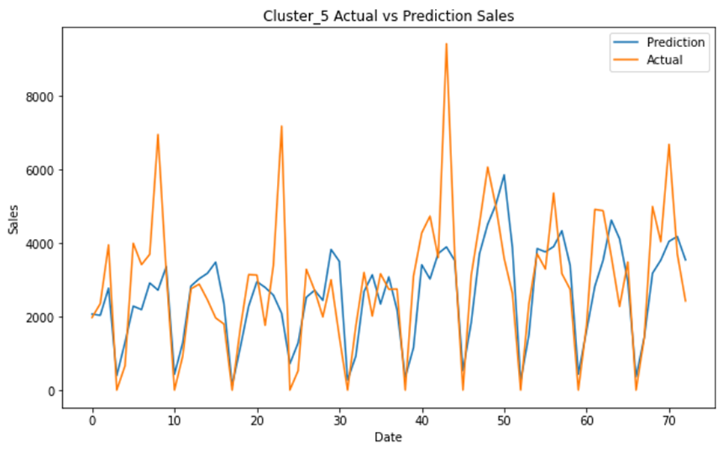
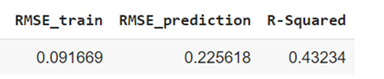
The Stacking Model For Cluster 5
The model in this cluster performed about the same as the other clusters.

Slide 30
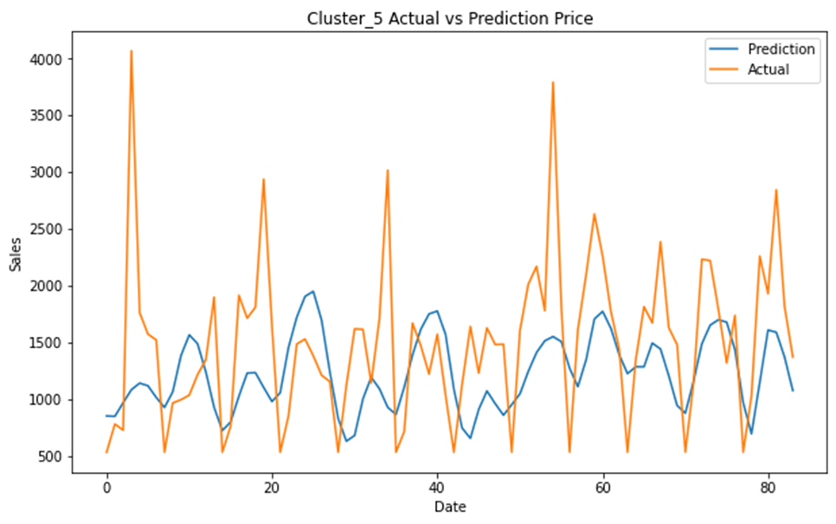
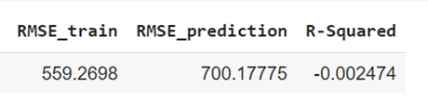
The LSTM Model For Cluster 5
The LSTM model in this cluster didn’t perform well.

Slide 31
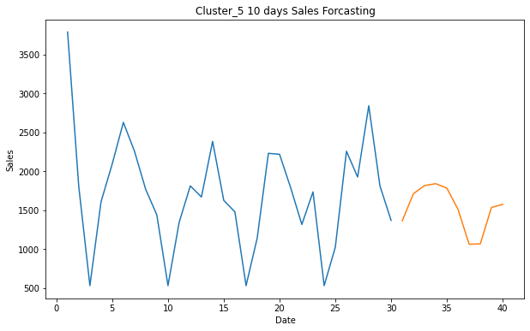
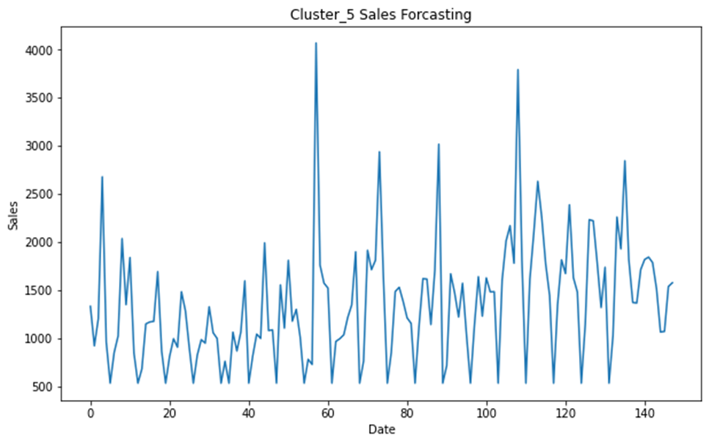
LSTM Forecasting For Cluster 5
The model didn’t perform well, so we expected the forecasting to be bad.

Slide 32
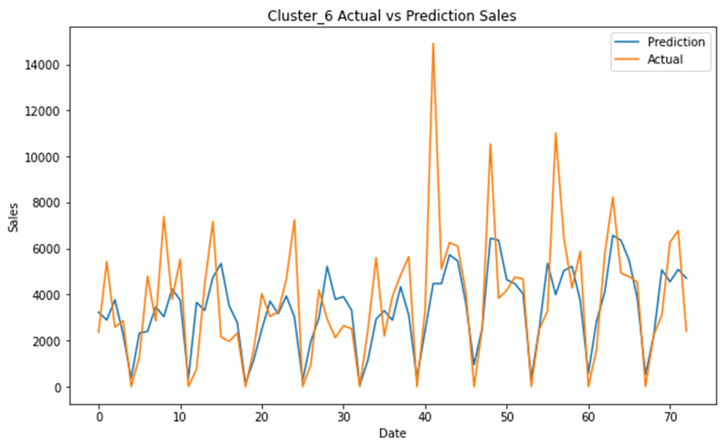
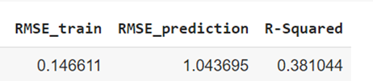
The Stacking Model For Cluster 6
This model had the lowest performance score of all clusters.

Slide 33
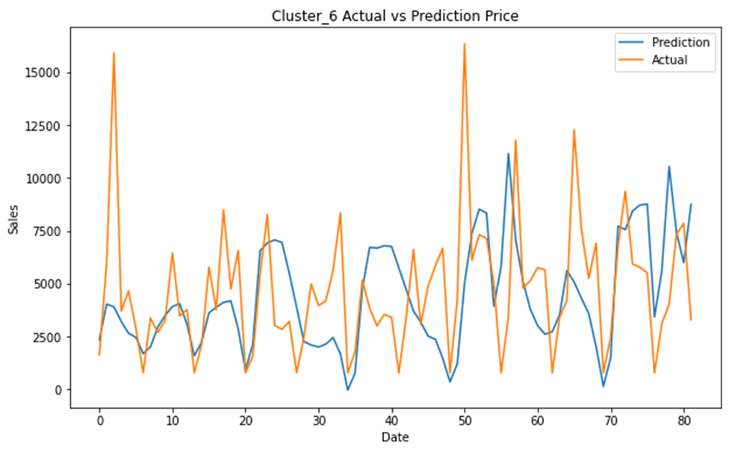
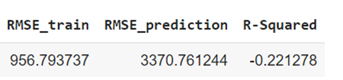
LSTM Model For Cluster 6
It is overfitted for this cluster.

Slide 34


LSTM Forecasting For Cluster 6
Even though the model didn’t perform well, the forecasting results shown are not bad.

Slide 35


The Stacking Model For Cluster 7
So far amongst the 7 clusters the model performed the best in this cluster.

Slide 36


The LSTM Model For Cluster 7
The model is overfitted for this cluster’s dataset.

Slide 37


The LSTM Model Forecasting For Cluster 7
The Forecasting results show the pattern is the same as the previous days.

Slide 38


The Stacking Model For Cluster 8
The performance metrics show that the model performed better than it did in cluster 6.

Slide 39


The LSTM Model For Cluster 8
The model is overfitted in this cluster but the graph visually isn’t bad.

Slide 40


LSTM Forecasting For Cluster 8
The forecast for this cluster shows a high spike.

Slide 41


The Stacking Model For Cluster 9
The performance metrics show that the model performed better than all the other pervious clusters with 52% R-Squared score.

Slide 42


The LSTM Model For Cluster 9
The model is overfitted for this cluster.

Slide 43


The LSTM Forecasting For Cluster 9
The forecasting result for this cluster is fine.

Slide 44


The Stacking Model For Cluster 10
The model performed about the same as it did in cluster 9.

Slide 45


LSTM Model For Cluster 10
The model is overfitted for this cluster too.

Slide 46


LSTM Model Forecasting For Cluster 10
The forecasting result of the model for this cluster is not the best.

Slide 47

The 10 days Forecasting for Each cluster
*On days where no sales were made on different clusters it seemed to have had an impact when it came to forecasting producing some negative values in our forecast.

Slide 48
Conclusion
We found the E-Commerce data is helpful to explore various techniques of Data Science.
Tableau was used in the analysis to visualize the data
We implemented NLP to preprocess the data.
We implemented topic modeling. Specifically, LDA model which grouped the data into 10 different topics with a coherence score of 63%.
We acquired the skill of taking the results of our clustering and applying it to our dataset to be able to run prediction models from it.
Built prediction model for each cluster. Specifically, Stacking and the LSTM model.
The stacking model performed well in all clusters with a performance score of R-Squared between 38% to 52%.
LSTM model performed best on cluster 1, on the rest of the clusters it was overfitted due to the small amount of entries in each cluster.
The forecasting by LSTM model was not bad and provided some decent results.

Slide 49
Future Work
Train the prediction model with more data so that we can get better performance. Check if more data has been collected since 2011 and add it in.
Test on a different E-Commerce dataset maybe one that isn’t tied down to a specific type of product to see how the results may vary.
Test other models outside our expertise for example Market Basket Analysis and various others.

Slide 50
References
Brownlee, Jason. (2020). Stacking Ensemble Machine Learning With Python. Machine learning Mastery.
https://machinelearningmastery.com/stacking-ensemble-machine-learning-with-python/
Prabhakaran, Selva. (2018). Topic Modeling with Gensim (Python). Machine Learning +.
https://www.machinelearningplus.com/nlp/topic-modeling-gensim-python/#9createbigramandtrigrammodels

